Slide 1
Death is inevitable. Sometime it occurs unexpectedly, other times, it stares us in the face. While many factors can cause death if not well managed, others are natural causes that one may have no or little control of. In this analysis, I looked at records of these causes of death in 204 countries , what causes the most death in a some countries and the likely reason the country suffer from it.
Exploratory Data Analysis
On The
Cause of Deaths
in
Countries

Slide 2
A Detailed Exploratory Data Analysis On Death Causes Presented By Lilian Chidinma Nwafor
7th December, 2022

Slide 3
Analytics Process
Data Collection:
The data was collected from kaggle: https://www.kaggle.com/datasets/iamsouravbanerjee/cause-of-deaths-around-the-world
Tools Used: python Jupiter Notebook with Matplotlib, Seaborn and pandas libraries.
Exploratory Data Analysis:
The datasets contained 6120 rows and 34 columns
There are 204 countries.
The year under review is 1990-2019 = 30 years
Columns renaming was done in excel spreadsheet

Slide 4
Discoveries
Zimbabwe recorded the maximum numbers in all variables.
In year 2019 'Respiratory_Diseases' has the highest average values of 19473.926471 while death by poisining recorded the lowest average of 378.088235.
The correlation test for relationship between numerical variables shows that Dementias has negative correlation with conflicts. Almost all the variables has Positive correlations
In year 1990, Zambia recorded highest cause of death from Meningitis, Vietnam from Dementias, Vietnam had total of 23,827 from Digestive_Diseases.
Focusing in Nigeria, It shows that all year, Malaria parasite is the cause of most death because of its score margin compared to he other death causes in Nigeria.
On Meningitis, Afghanistan recorded 2159 in 1990. Andorra recorded none. While Zambia had 2065 death, Zimbabwe 1450.
Taking analysis of the top 10 countries that had the highest score all year, China appeared as the only country scoring high from all causes of death, except that 2012-2016,2017-2019, China had no record of Malaria death. this may be due to her large population. Overall, there was a consistent rise in the yearly total death recorded on china, though there was a reduction in 2006 and 2007. The plot is shown below:

Slide 5
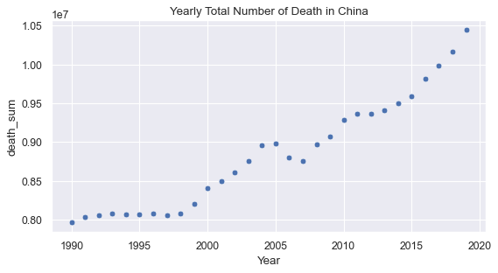
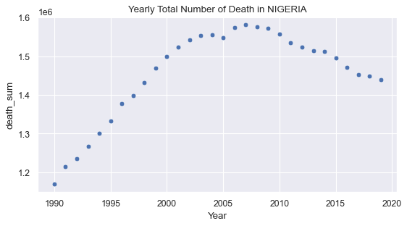
The above plot shows the record of deaths in China and Nigeria. 2 countries from different continents. While the death records rises in China from 2010, death record reduces in Nigeria same period.

Slide 6
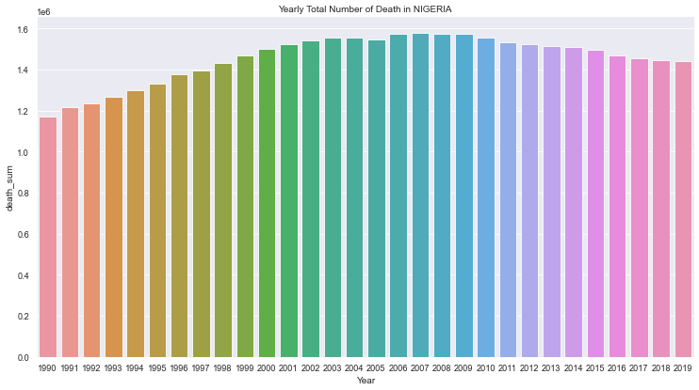
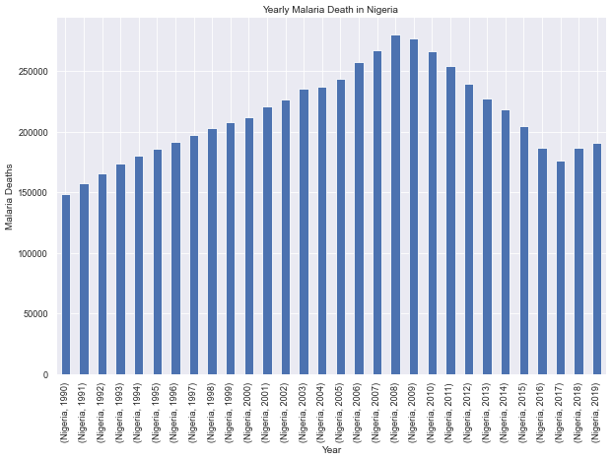
A focus on Nigeria
Plot 1: yearly total number of death
Plot 2: yealy record of Malaria death in Nigeria

Slide 7
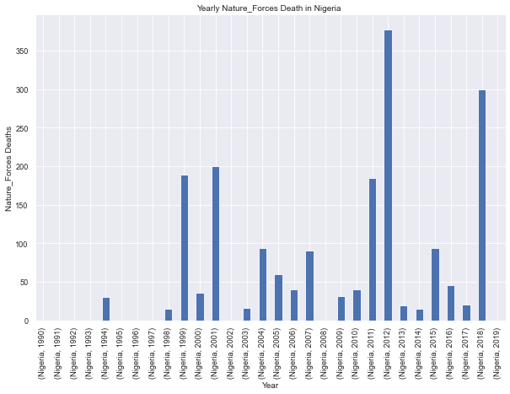
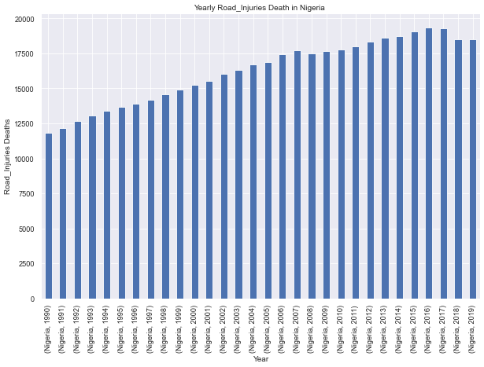
A focus on Nigeria
Plot 1: yearly cause of death from Natural forces
Plot 2: yearly cause of death from road inuries

Slide 8
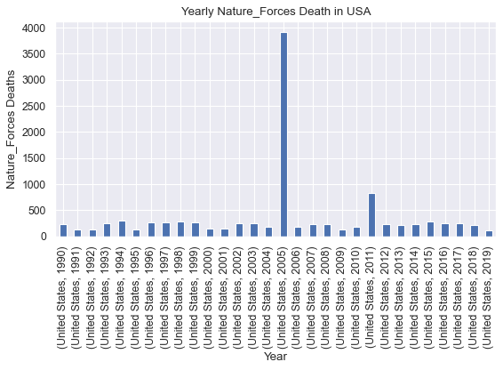
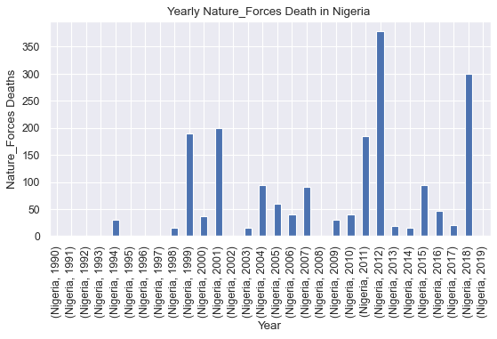
COMPARING NIGERIA VS USA DEATH RECORDS
Yearly Death Cause from nature Forces in USA and Nigeria. I chose to compare causes from a developed country and developing country of different continents.

Slide 9
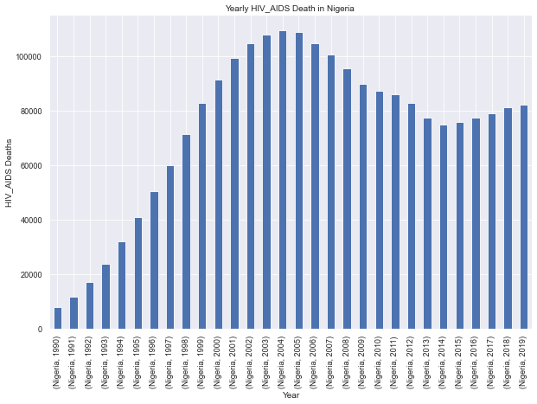
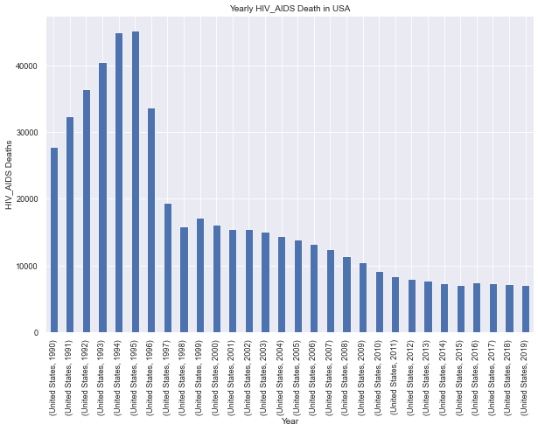
COMPARING NIGERIA VS USA DEATH RECORDS
Yearly Death Cause from HIV in USA and Nigeria. I chose to compare causes from a developed country and developing country of different continents.

Slide 10
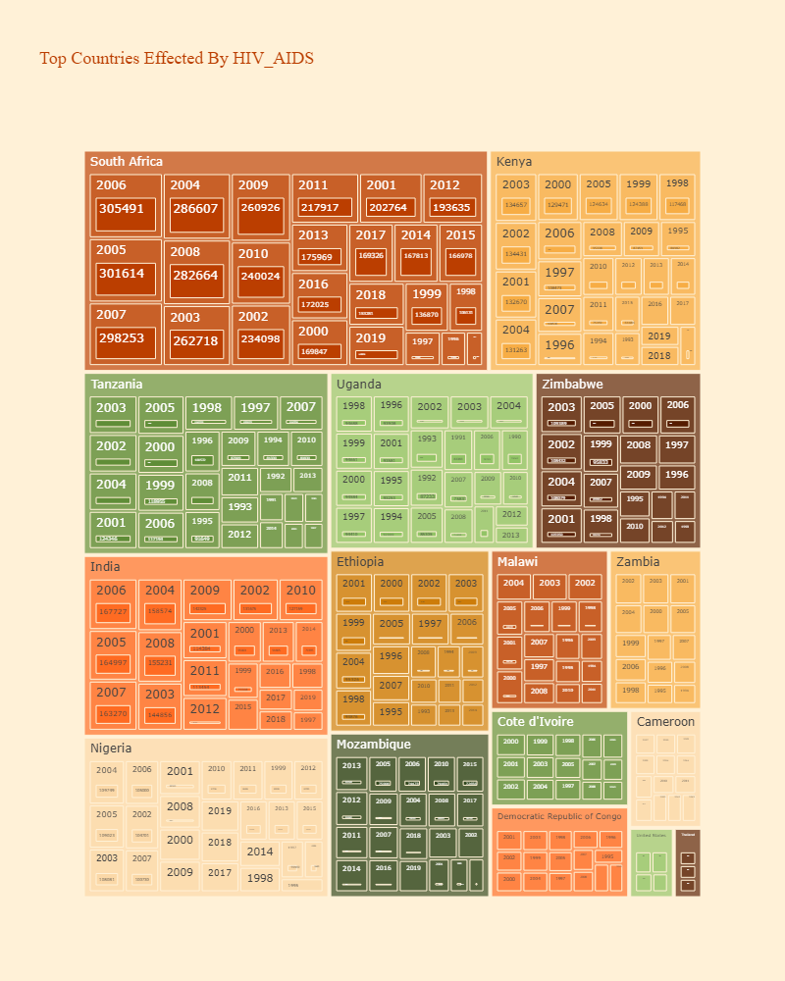
Top Countries affected by HIV
ON THE CHART :
SOUTH AFRICA
KENYA
TANZANIA
UGANDA
ZIMBABWE
INDIA
NIGERIA
ETHOPIA
MALAWI
ZAMBIA
MOZAMBIUE
COTE DIVORIE
CAMERON
CONGO

Slide 11
Lowest and highest record
The 3 countries with the least death records from all variables Tokelau, Niue and Nauru.
The 3 countries with the most death records from all variables China, India and United States.
Challenges
The challenges encountered was the delay in the program execution due to the large sum of the dataset. For instance I would love to have the overview of the countries and the variables on a multiple bar plot but the large dataset made it impossible
suggestion
In recent years, there is a great reduction in the cause of death by HIV in the USA compared to Nigeria. I suggest the United States health ministry should be contacted by Nigerian government for an advice.
conclusion
Governments of all countries should always look into statistics of other countries to know how they can improve on the health services, so that to reduce the high rate of death rise in their countries.

Slide 12
THANK YOU

